Slide 1

Unit III
K-Nearest Neighbors and Naive Bayes
SRM INSTITUTE OF SCIENCE AND TECHNOLOGY,
RAMAPURAM CAMPUS

Slide 2
Unit III
K-nearest neighbors
KNN voter example
Curse of dimensionality-Curse of dimensionality with 1D, 2D, and 3D example
Curse of dimensionality with 3D example
KNN classifier with breast cancer Wisconsin data example
Naive Bayes
Probability fundamentals - Joint probability
Understanding Bayes theorem with conditional probability
Naive Bayes classification
Laplace estimator
Naive Bayes SMS spam classification example

Slide 3
K-nearest neighbors
Definition - K-nearest neighbors is a non-parametric machine learning model in which the model memorizes the training observation for classifying the unseen test data.
Instance-based learning
This model is often termed as lazy learning, as it does not learn anything during the training phase like regression, random forest, and so on.
It starts working only during the testing/evaluation phase to compare the given test observations with nearest training observations

Slide 4
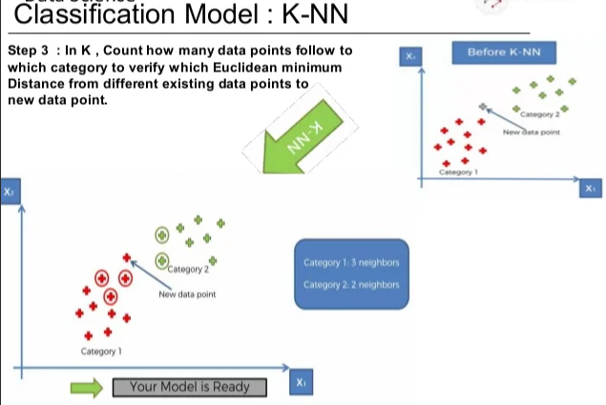
K-nearest neighbors

Slide 5
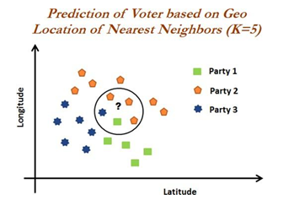
K-nearest neighbors
KNN voter example
Objective is to predict the party for which voter will vote based on their neighborhood, precisely geolocation (latitude and longitude).
Assumption - Identify the potential voter to which political party they would be voting based on majority voters did voted for that particular party.
Tuning the k-value (number to consider, among which majority should be counted) is the million- dollar question (as same as any machine learning algorithm)

Slide 6
K-nearest neighbors
Curse of dimensionality
The curse of dimensionality refers to the phenomena that occur when classifying, organizing, and analyzing high dimensional data that does not occur in low dimensional spaces, specifically the issue of data sparsity and “closeness” of data.
Points in high-dimensional spaces tend to be dispersing from each other more compared with the points in low-dimensional space.
uniform random values between zero and one generated for 1D, 2D, and 3D space to validate this hypothesis

Slide 7
K-nearest neighbors
mean distance between 1,000 observations have been calculated with the change in dimensions.
It is apparent that with the increase in dimensions, distance between points increases logarithmically, which gives us the hint that we need to have exponential increase in data points with increase in dimensions in order to make machine learning algorithms work correctly
>>> import numpy as np
>>> import pandas as pd
# KNN Curse of Dimensionality
>>> import random,math

Slide 8
K-nearest neighbors
The following code generates random numbers between zero and one from uniform distribution with the given dimension, which is equivalent of length of array or list:
>>> def random_point_gen(dimension):
... return [random.random() for _ in range(dimension)]
calculates root mean sum of squares of Euclidean distances (2-norm) between points by taking the difference between points and sum the squares and finally takes square root of total distance:
>>> def distance(v,w):
... vec_sub = [v_i-w_i for v_i,w_i in zip(v,w)]
... sum_of_sqrs = sum(v_i*v_i for v_i in vec_sub)
... return math.sqrt(sum_of_sqrs)

Slide 9
K-nearest neighbors
Both dimension and number of pairs are utilized for calculating the distances with the following code:
>>> def random_distances_comparison(dimension,number_pairs):
... return[distance(random_point_gen(dimension),random_point_gen(dimension))
for _ in range(number_pairs)]
>>> def mean(x):
... return sum(x) / len(x)
changing dimensions from 1 to 201 with the increase of 5 dimensions to check the increase in distance:
>>> dimensions = range(1, 201, 5)

Slide 10
K-nearest neighbors
Both minimum and average distances have been calculated to check,
>>> avg_distances = []
>>> min_distances = []
>>> dummyarray = np.empty((20,4))
>>> dist_vals = pd.DataFrame(dummyarray)
>>> dist_vals.columns = ["Dimension","Min_Distance","Avg_Distance","Min/Avg_Distance”]
>>> random.seed(34)
>>> i = 0
>>> for dims in dimensions:
... distances = random_distances_comparison(dims, 1000)
... avg_distances.append(mean(distances))
... min_distances.append(min(distances))
... dist_vals.loc[i,"Dimension"] = dims
... dist_vals.loc[i,"Min_Distance"] = min(distances)
... dist_vals.loc[i,"Avg_Distance"] = mean(distances)
... dist_vals.loc[i,"Min/Avg_Distance"] = min(distances)/mean(distances)
... print(dims, min(distances), mean(distances), min(distances)*1.0 / mean( distances))
... i = i+1

Slide 11
K-nearest neighbors
# Plotting Average distances for Various Dimensions
>>> import matplotlib.pyplot as plt
>>> plt.figure()
>>> plt.xlabel('Dimensions')
>>> plt.ylabel('Avg. Distance')
>>> plt.plot(dist_vals["Dimension"],dist_vals["Avg_Distance"])
>>> plt.legend(loc='best')
>>> plt.show()

Slide 12
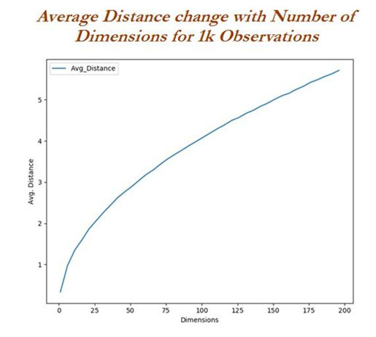
K-nearest neighbors
From the graph, it is proved that with the increase in dimensions, mean distance increases logarithmically.
Hence the higher the dimensions, the more data is needed to overcome the curse of dimensionality!

Slide 13
K-nearest neighbors
Curse of dimensionality with 1D
distance of 60 random points are expanding with the increase in dimensionality.
# 1-Dimension Plot
>>> import numpy as np
>>> import pandas as pd
>>> import matplotlib.pyplot as plt
>>> one_d_data = np.random.rand(60,1)
>>> one_d_data_df = pd.DataFrame(one_d_data)
>>> one_d_data_df.columns = ["1D_Data"]
>>> one_d_data_df["height"] = 1
>>> plt.figure()
>>> plt.scatter(one_d_data_df['1D_Data'],one_d_data_df["height"])
>>> plt.yticks([])
>>> plt.xlabel("1-D points")
>>> plt.show()

Slide 14
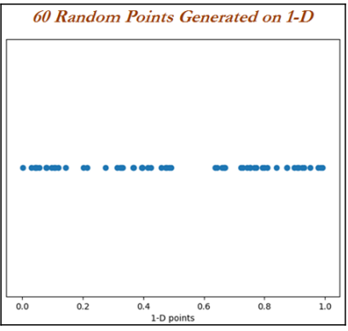
K-nearest neighbors

Slide 15
K-nearest neighbors
Curse of dimensionality with 2D
60 random numbers with x and y co-ordinate space
# 2- Dimensions Plot
>>> two_d_data = np.random.rand(60,2)
>>> two_d_data_df = pd.DataFrame(two_d_data)
>>> two_d_data_df.columns = ["x_axis","y_axis"]
>>> plt.figure()
>>> plt.scatter(two_d_data_df['x_axis'],two_d_data_df["y_axis"])
>>> plt.xlabel("x_axis");plt.ylabel("y_axis")
>>> plt.show()

Slide 16
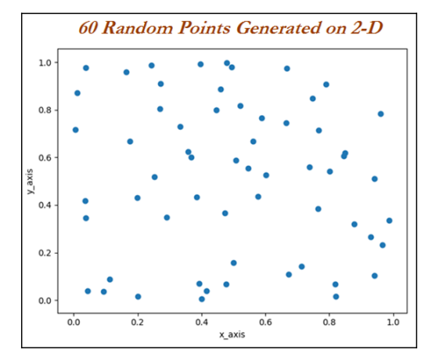
K-nearest neighbors

Slide 17
K-nearest neighbors
Curse of dimensionality with 3D
60 data points are drawn for 3D space
increase in spaces, which is very apparent.
This has proven to us visually that with the increase in dimensions, it creates lot of space, which makes a classifier weak to detect the signal
# 3- Dimensions Plot
>>> three_d_data = np.random.rand(60,3)
>>> three_d_data_df = pd.DataFrame(three_d_data)
>>> three_d_data_df.columns = ["x_axis","y_axis","z_axis"]
>>> from mpl_toolkits.mplot3d import Axes3D
>>> fig = plt.figure()
>>> ax = fig.add_subplot(111, projection='3d')
>>>
ax.scatter(three_d_data_df['x_axis'],three_d_data_df["y_axis"],three_d_data
_df ["z_axis"])
>>> plt.show()

Slide 18
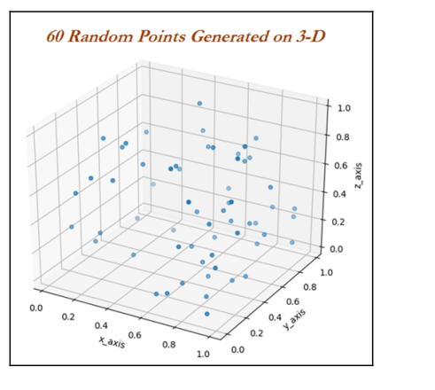
K-nearest neighbors

Slide 19
K-nearest neighbors
KNN classifier with breast cancer Wisconsin data example
Breast cancer data has been utilized from the UCI machine learning repository http://archive.ics.uci.edu/ml/datasets/Breast+Cancer+Wisconsin+%28Diagnostic%29
To find whether the cancer is malignant or benign based on various collected features such as clump thickness and so on using the KNN classifier
# KNN Classifier - Breast Cancer
>>> import numpy as np
>>> import pandas as pd
>>> from sklearn.metrics import accuracy_score,classification_report
>>> breast_cancer = pd.read_csv("Breast_Cancer_Wisconsin.csv")

Slide 20
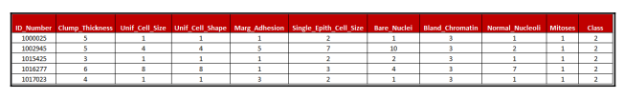
K-nearest neighbors
KNN classifier with breast cancer Wisconsin data example
The Class value has class 2 and 4. Value 2 and 4 represent benign and malignant class, respectively.
Whereas all the other variables do vary between value 1 and 10, which are very much categorical in nature

Slide 21
K-nearest neighbors
KNN classifier with breast cancer Wisconsin data example
the Bare_Nuclei variable has some missing values, here we are replacing them with the most frequent value (category value 1) in the following code:
>>>breast_cancer['Bare_Nuclei']= breast_cancer['Bare_Nuclei'].replace('?', np.NAN)
>>>breast_cancer['Bare_Nuclei'] = breast_cancer['Bare_Nuclei'].fillna(breast_cancer[ 'Bare_Nuclei'].value_counts().index[0])
Use the following code to convert the classes to a 0 and 1 indicator for using in the classifier:
>>> breast_cancer['Cancer_Ind'] = 0
>>>breast_cancer.loc[breast_cancer['Class']==4,'Cancer_Ind '] = 1

Slide 22
K-nearest neighbors
KNN classifier with breast cancer Wisconsin data example
we are dropping non-value added variables from analysis:
>>> x_vars = breast_cancer.drop(['ID_Number','Class','Cancer_Ind'],axis=1)
>>> y_var = breast_cancer['Cancer_Ind']
>>> from sklearn.preprocessing import StandardScaler
>>> x_vars_stdscle = StandardScaler().fit_transform(x_vars.values)
>>> from sklearn.model_selection import train_test_split
As KNN is very sensitive to distances, here we are standardizing all the columns before applying algorithms:
>>> x_vars_stdscle_df = pd.DataFrame(x_vars_stdscle, index=x_vars.index,
columns=x_vars.columns)
>>> x_train,x_test,y_train,y_test =
train_test_split(x_vars_stdscle_df,y_var, train_size = 0.7,random_state=42)

Slide 23
K-nearest neighbors
KNN classifier with breast cancer Wisconsin data example
KNN classifier is being applied with neighbor value of 3 and p value indicates it is 2-norm, also known as Euclidean distance for computing classes:
>>> from sklearn.neighbors import KNeighborsClassifier
>>> knn_fit = KNeighborsClassifier(n_neighbors=3,p=2,metric='minkowski')
>>> knn_fit.fit(x_train,y_train)
>>> print ("\nK-Nearest Neighbors - Train Confusion Matrix\n\n",pd.crosstab(y_train, knn_fit.predict(x_train),rownames = ["Actuall"],colnames = ["Predicted"]) )
>>> print ("\nK-Nearest Neighbors - Train accuracy:",round(accuracy_score(y_train, knn_fit.predict(x_train)),3))
>>> print ("\nK-Nearest Neighbors - Train Classification Report\n", classification_report( y_train,knn_fit.predict(x_train)))
>>> print ("\n\nK-Nearest Neighbors - Test Confusion Matrix\n\n",pd.crosstab(y_test, knn_fit.predict(x_test),rownames = ["Actuall"],colnames = ["Predicted"]))
>>> print ("\nK-Nearest Neighbors - Test accuracy:",round(accuracy_score( y_test,knn_fit.predict(x_test)),3))
>>> print ("\nK-Nearest Neighbors - Test Classification Report\n", classification_report(y_test,knn_fit.predict(x_test)))

Slide 24
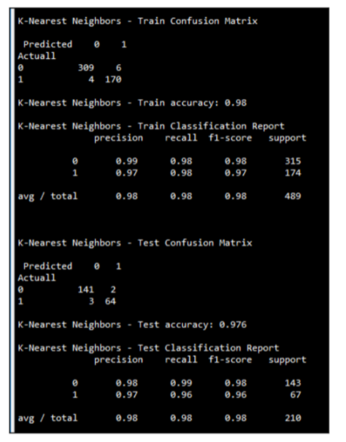
K-nearest neighbors
KNN classifier with breast cancer Wisconsin data example

Slide 25
K-nearest neighbors
KNN classifier with breast cancer Wisconsin data example
From the results, it is appearing that KNN is working very well in classifying malignant and benign classes well
Obtains test accuracy of 97.6 percent with 96 percent of recall on
malignant class.
The only deficiency of KNN classifier would be, it is computationally
intensive during test phase, as each test observation will be compared with all the available observations in train data, which practically KNN does not learn a thing from training data. Hence, we are also calling it a lazy classifier!

Slide 26
K-nearest neighbors
KNN classifier with breast cancer Wisconsin data example
R - Programming Language
The R code for KNN classifier is as follows:
# KNN Classifier
setwd("D:\\Book writing\\Codes\\Chapter 5") breast_cancer = read.csv("Breast_Cancer_Wisconsin.csv")
# Column Bare_Nuclei have some missing values with "?" in place, we are replacing with median values and As Bare_Nuclei is discrete variable
breast_cancer$Bare_Nuclei = as.character(breast_cancer$Bare_Nuclei) breast_cancer$Bare_Nuclei[breast_cancer$Bare_Nuclei=="?"] = median(breast_cancer$Bare_Nuclei,na.rm = TRUE) breast_cancer$Bare_Nuclei = as.integer(breast_cancer$Bare_Nuclei)
# Classes are 2 & 4 for benign & malignant respectively, we # have converted #to zero-one problem, as it is easy to convert to work # around with models breast_cancer$Cancer_Ind = 0 breast_cancer$Cancer_Ind[breast_cancer$Class==4]=1 breast_cancer$Cancer_Ind = as.factor( breast_cancer$Cancer_Ind)

Slide 27
K-nearest neighbors
KNN classifier with breast cancer Wisconsin data example
R - Programming Language
# We have removed unique id number from modeling as unique # numbers does not provide value in modeling
# In addition, original class variable also will be removed # as the same has been replaced with derived variable
remove_cols = c("ID_Number","Class")
breast_cancer_new = breast_cancer[,!(names(breast_cancer) %in% remove_cols)]
# Setting seed value for producing repetitive results # 70-30 split has been made on the data
set.seed(123)
numrow = nrow(breast_cancer_new)
trnind = sample(1:numrow,size = as.integer(0.7*numrow)) train_data = breast_cancer_new[trnind,]
test_data = breast_cancer_new[-trnind,]

Slide 28
K-nearest neighbors
KNN classifier with breast cancer Wisconsin data example
R - Programming Language
# Following is classical code for computing accuracy, # precision & recall
frac_trzero = (table(train_data$Cancer_Ind)[[1]])/nrow(train_data)
frac_trone = (table(train_data$Cancer_Ind)[[2]])/nrow(train_data)
frac_tszero = (table(test_data$Cancer_Ind)[[1]])/nrow(test_data)
frac_tsone = (table(test_data$Cancer_Ind)[[2]])/nrow(test_data)
prec_zero <- function(act,pred){ tble = table(act,pred)
return( round( tble[1,1]/(tble[1,1]+tble[2,1]),4) ) }
prec_one <- function(act,pred){ tble = table(act,pred) return( round( tble[2,2]/(tble[2,2]+tble[1,2]),4) ) }
recl_zero <- function(act,pred){tble = table(act,pred) return( round( tble[1,1]/(tble[1,1]+tble[1,2]),4) ) }
recl_one <- function(act,pred){ tble = table(act,pred) return( round( tble[2,2]/(tble[2,2]+tble[2,1]),4) ) }
accrcy <- function(act,pred){ tble = table(act,pred) return( round((tble[1,1]+tble[2,2])/sum(tble),4)) }

Slide 29
K-nearest neighbors
KNN classifier with breast cancer Wisconsin data example
R - Programming Language
# Importing Class package in which KNN function do present library(class) # Choosing sample k-value as 3 & apply on train & test data # respectively k_value = 3
tr_y_pred = knn(train_data,train_data,train_data$Cancer_Ind,k=k_value)
ts_y_pred = knn(train_data,test_data,train_data$Cancer_Ind,k=k_value)

Slide 30
K-nearest neighbors
KNN classifier with breast cancer Wisconsin data example
R - Programming Language
# Calculating confusion matrix, accuracy, precision & # recall on train data
tr_y_act = train_data$Cancer_Ind;ts_y_act = test_data$Cancer_Ind tr_tble = table(tr_y_act,tr_y_pred)
print(paste("Train Confusion Matrix")) print(tr_tble)
tr_acc = accrcy(tr_y_act,tr_y_pred)
trprec_zero = prec_zero(tr_y_act,tr_y_pred); trrecl_zero = recl_zero(tr_y_act,tr_y_pred)
trprec_one = prec_one(tr_y_act,tr_y_pred); trrecl_one = recl_one(tr_y_act,tr_y_pred)
trprec_ovll = trprec_zero *frac_trzero + trprec_one*frac_trone trrecl_ovll = trrecl_zero *frac_trzero + trrecl_one*frac_trone

Slide 31
K-nearest neighbors
KNN classifier with breast cancer Wisconsin data example
R - Programming Language
# Calculating confusion matrix, accuracy, precision & # recall on train data
print(paste("KNN Train accuracy:",tr_acc)) print(paste("KNN - Train Classification Report"))
print(paste("Zero_Precision",trprec_zero,"Zero_Recall",trrecl_zero)) print(paste("One_Precision",trprec_one,"One_Recall",trrecl_one)) print(paste("Overall_Precision",round(trprec_ovll,4),"Overall_Recall",round (trrecl_ovll,4)))

Slide 32
K-nearest neighbors
KNN classifier with breast cancer Wisconsin data example
R - Programming Language
# Calculating confusion matrix, accuracy, precision & # recall on test data ts_tble = table(ts_y_act, ts_y_pred)
print(paste("Test Confusion Matrix"))
print(ts_tble)
ts_acc = accrcy(ts_y_act,ts_y_pred)
tsprec_zero = prec_zero(ts_y_act,ts_y_pred); tsrecl_zero = recl_zero(ts_y_act,ts_y_pred)
tsprec_one = prec_one(ts_y_act,ts_y_pred); tsrecl_one = recl_one(ts_y_act,ts_y_pred)
tsprec_ovll = tsprec_zero *frac_tszero + tsprec_one*frac_tsone tsrecl_ovll = tsrecl_zero *frac_tszero + tsrecl_one*frac_tsone
print(paste("KNN Test accuracy:",ts_acc)) print(paste("KNN - Test Classification Report"))
print(paste("Zero_Precision",tsprec_zero,"Zero_Recall",tsrecl_zero)) print(paste("One_Precision",tsprec_one,"One_Recall",tsrecl_one)) print(paste("Overall_Precision",round(tsprec_ovll,4),"Overall_Recall",round (tsrecl_ovll,4)))

Slide 33
Naive Bayes
The Naive Bayes is a classification algorithm that is suitable for binary and multiclass classification.
Naïve Bayes performs well in cases of categorical input variables compared to numerical variables.
It is useful for making predictions and forecasting data based on historical results.
The distinction between Bayes theorem and Naive Bayes is that Naive Bayes assumes conditional independence where Bayes theorem does not.
This means the relationship between all input features are independent. Maybe not a great assumption, but this is is why the algorithm is called “naive

Slide 34
Naive Bayes
Thomas developed the foundational mathematical principles for determining the probability of unknown events from the known events.
For example, if all apples are red in color and average diameter would be about 4 inches then, if at random one fruit is selected from the basket with red color and diameter of 3.7 inch, what is the probability that the particular fruit would be an apple?
Naive term does assume independence of particular features in a class with respect to others.
In this case, there would be no dependency between color and diameter.
This independence assumption makes the Naive Bayes classifier most effective in terms of computational ease for particular tasks
Bayesian classifiers are best applied to problems in which information from a very high number of attributes should be considered simultaneously to estimate the probability of final outcome.

Slide 35
Naive Bayes
Probability fundamentals
Probability of an event can be estimated from observed data by dividing the number of trails in which an event occurred with total number of trails.
For instance, if a bag contains red and blue balls and randomly picked 10 balls one by one with replacement and out of 10, 3 red balls appeared in trails we can say that
probability of red is 0.3, pred = 3/10 = 0.3.
Total probability of all possible outcomes must be 100 percent.

Slide 36
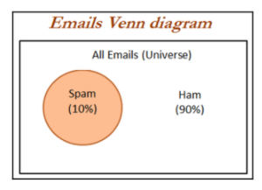
Naive Bayes
Probability fundamentals
If a trail has two outcomes such as email classification either it is spam or ham and both cannot occur simultaneously, these events are considered as mutually exclusive with each other.
In addition, if those outcomes cover all possible events, it would be called as exhaustive events.
For example, in email classification if P (spam) = 0.1, we will be able to calculate P (ham) = 1- 0.1 = 0.9, these two events are mutually exclusive

Slide 37
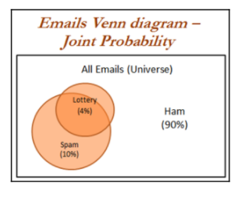
Naive Bayes
Joint probability
Though mutually exclusive cases are simple to work upon, most of the actual problems do fall under the category of non-mutually exclusive events.
By using the joint appearance, we can predict the event outcome.
For example, if emails messages present the word like lottery, which is very highly likely of being spam rather than ham.
The spam messages contain the word lottery and not every email with the word lottery is spam.

Slide 38
Naive Bayes
Joint probability
the joint probability of both p(spam) and p(lottery) occurring, which can be written as p(spam ∩ lottery).
In case if both the events are totally unrelated, they are called independent events and their respective value is p(spam ∩ lottery) = p(spam) * p(lottery) = 0.1 * 0.04 = 0.004, which is 0.4 percent of all messages are spam containing the word Lottery.
In general, for independent events P(A∩ B) = P(A) * P(B).

Slide 39

Naive Bayes
Understanding Bayes theorem with conditional probability
Conditional probability provides a way of calculating relationships between dependent events using Bayes theorem.
For example, A and B are two events and we would like to calculate P(A\B) can be read as the probability of event occurring A given the fact that event B already occurred, in fact this is known as conditional probability,
The equation can be written as follows:

Slide 40
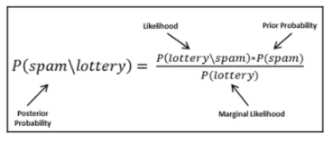
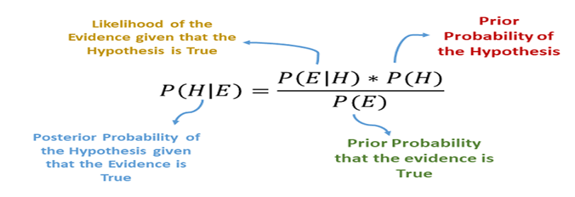
Naive Bayes
Understanding Bayes theorem with conditional probability
Email classification example - Objective is to predict whether email is spam given the word lottery and some other clues.
In this case we already knew the overall probability of spam, which is 10 percent also known as prior probability.
Now suppose you have obtained an additional piece of information that probability of word lottery in all messages, which is 4 percent, also known as marginal likelihood.
Now, we know the probability that lottery was used in previous spam messages and is called the likelihood.

Slide 41
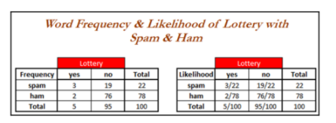
Naive Bayes
Understanding Bayes theorem with conditional probability
By applying the Bayes theorem to the evidence, we can calculate the posterior probability that calculates the probability that the message is how likely being a spam; given the fact that lottery was appearing in message.
On average if the probability is greater than 50 percent it indicates that the message is spam rather than ham.

Slide 42
Naive Bayes
Understanding Bayes theorem with conditional probability
sample frequency table that records the number of times Lottery appeared in spam and ham messages and its respective likelihood has been shown.
Likelihood table reveals that P(Lottery\Spam)= 3/22 = 0.13, indicating that probability is 13 percent that a spam message contains the term Lottery.
Subsequently we can calculate the P(Spam ∩ Lottery) = P(Lottery\Spam) * P(Spam) = (3/22) * (22/100) = 0.03.
In order to calculate the posterior probability, we divide P(Spam ∩ Lottery) with P(Lottery), which means (3/22)*(22/100) / (4/100) = 0.75
Therefore, the probability is 75 percent that a message is spam, given that message contains the word Lottery.

Slide 43
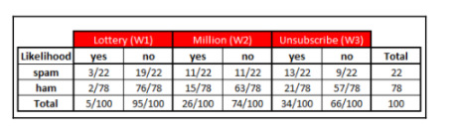
Naive Bayes
Naive Bayes classification
Let us construct the likelihood table for the appearance of the three words (W1, W2, and W3), as shown in the following table for 100 emails:

Slide 44

Naive Bayes
Naive Bayes classification
When a new message is received, the posterior probability will be calculated to determine that email message is spam or ham. Let us assume that we have an email with terms Lottery and Unsubscribe, but it does not have word Million in it, with this details, what is the probability of spam?
By using Bayes theorem, we can define the problem as Lottery = Yes, Million = No and Unsubscribe = Yes:
Solving the preceding equations will have high computational complexity due to the dependency of words with each other. As more number of words are added, this will even explode and also huge memory will be needed for processing all possible intersecting events. This finally leads to intuitive turnaround with independence of words (cross- conditional independence)

Slide 45

Naive Bayes
Naive Bayes classification
When both events are independent we can write P(A ∩ B) = P(A) * P(B). In fact, this equivalence is much easier to compute with less memory requirement:
In a similar way, we will calculate the probability for ham messages as well, as follows:

Slide 46

Naive Bayes
Naive Bayes classification
By substituting the preceding likelihood table in the equations, due to the ratio of spam/ham we can just simply ignore the denominator terms in both the equations. Overall likelihood of spam is:

Slide 47

Naive Bayes
Naive Bayes classification
After calculating ratio, 0.008864/0.004349 = 2.03, which means that this message is two times more likely to be spam than ham. But we can calculate the probabilities as follows

Slide 48
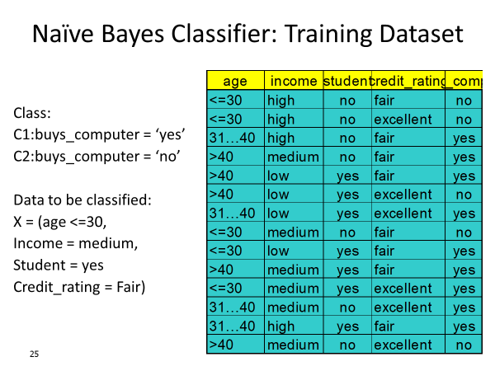
Naive Bayes

Slide 49
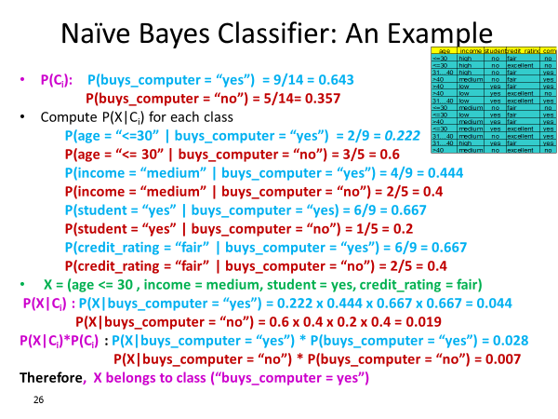
Naive Bayes

Slide 50
Laplace estimator
In the previous calculation, all the values are nonzeros, which makes calculations well. Whereas in practice some words never appear in past for specific category and suddenly appear at later stages, which makes entire calculations as zeros
For example, in the previous equation W3 did have a 0 value instead of 13, and it will convert entire equations to 0 altogether
In order to avoid this situation, Laplace estimator essentially adds a small number to each of the counts in the frequency table, which ensures that each feature has a nonzero probability of occurring with each class. Usually Laplace estimator is set to 1, which ensures that each class-feature combination is found in the data at least once

Slide 51
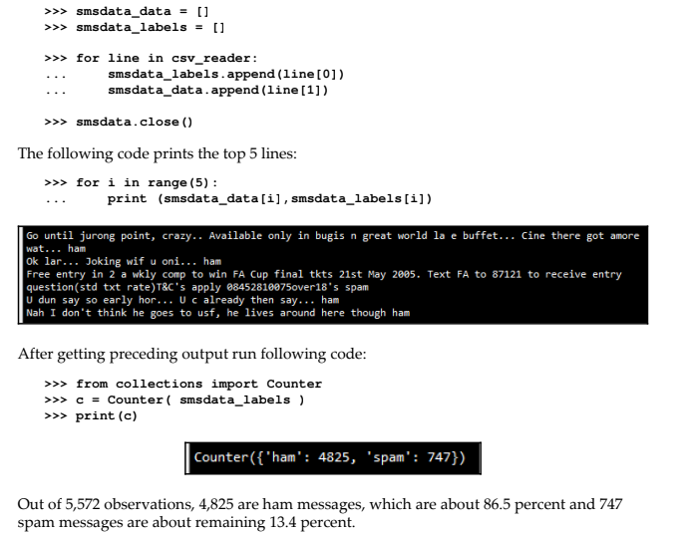
Naive Bayes SMS spam classification example
Dat set : SMS spam collection
NLP techniques to preprocess prior to build the Naive Bayes model
>>> import csv
>>> smsdata = open('SMSSpamCollection.txt','r')
>>> csv_reader = csv.reader(smsdata,delimiter='\t')

Slide 52
Naive Bayes SMS spam classification example
Preprocessing stages are
Removal of punctuations
Word tokenization: Words are chunked from sentences based on white space for further processing
Converting words into lower case: Converting to all lower case provides removal of duplicates, such as Run and run, where the first one comes at start of the sentence and the later one comes in the middle of the sentence, and so on
Stop word removal: Stop words are the words that repeat so many times in literature and yet are not much differentiator in explanatory power of sentences. For example: I, me, you, this, that, and so on, which needs to be removed before further processing
of length at least three: Here we have removed words with length less than three
Stemming of words: Stemming process stems the words to its respective root words. Example of stemming is bringing down running to run or runs to run. By doing stemming we reduce duplicates and improve the accuracy of the model
Part-of-speech (POS) tagging: This applies the speech tags to words, such as noun, verb, adjective, and so on. For example, POS tagging for running is verb, whereas for run is noun. In some situation running is noun and lemmatization will not bring down the word to root word run, instead it just keeps the running as it is.
Lemmatization of words: Lemmatization is another different process to reduce the dimensionality. In lemmatization process, it brings down the word to root word rather than just truncating the words. For example, bring ate to its root word as eat when we pass the ate word into lemmatizer with the POS tag as verb.

Slide 53
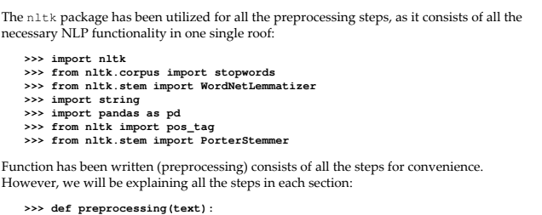
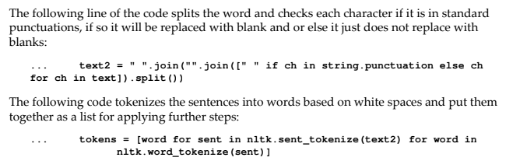
Naive Bayes SMS spam classification example

Slide 54
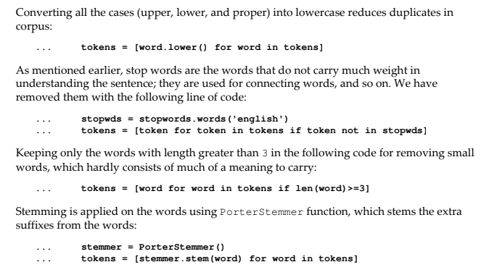
Naive Bayes SMS spam classification example

Slide 55

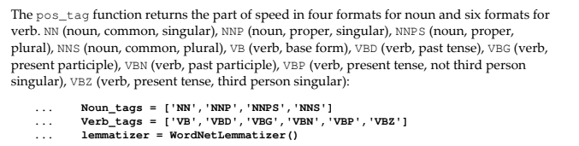
Naive Bayes SMS spam classification example

Slide 56
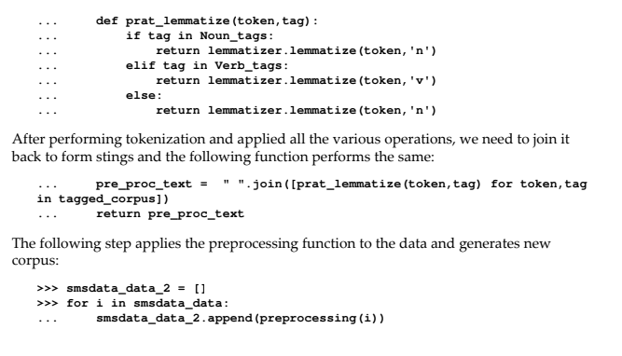
Naive Bayes SMS spam classification example

Slide 57
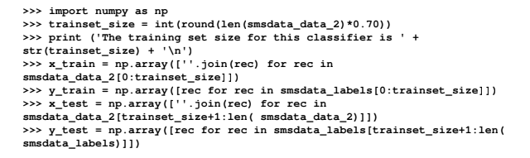
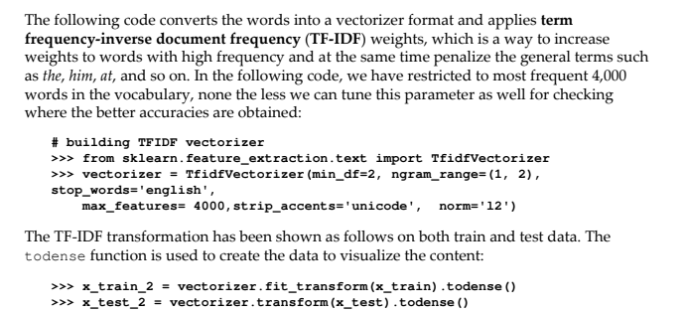
Naive Bayes SMS spam classification example

Slide 58
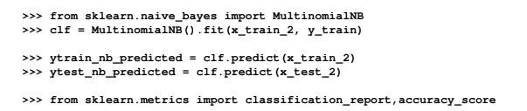
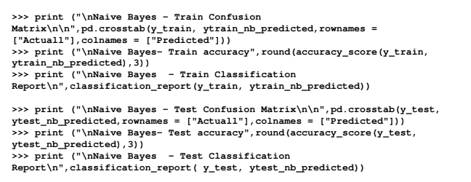
Naive Bayes SMS spam classification example

Slide 59
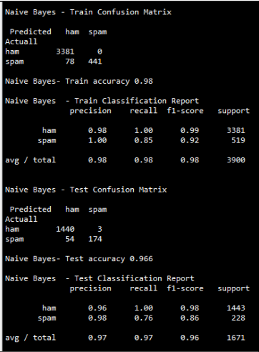
Naive Bayes SMS spam classification example

Slide 60
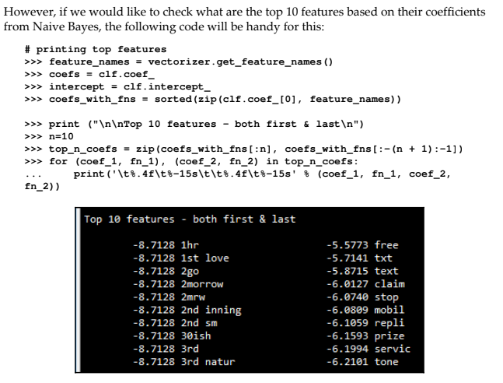
Naive Bayes SMS spam classification example

Slide 61
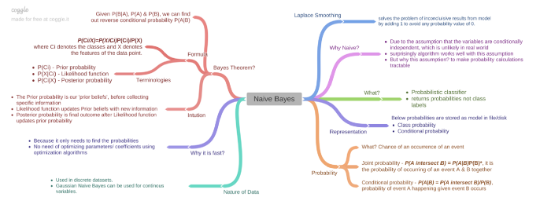
Naive Bayes - Mind Map

